Slide 1
Capstone Project - The Battle of Neighborhoods
Kokularaj

Slide 2
New Restaurant in Colombo city
Before open a business in a new town an analytical must be done in order to prevent the loss.
For that Colombo Restaurant details were gained and analysed.

Slide 3
Data
Data were collected from folium

Slide 4
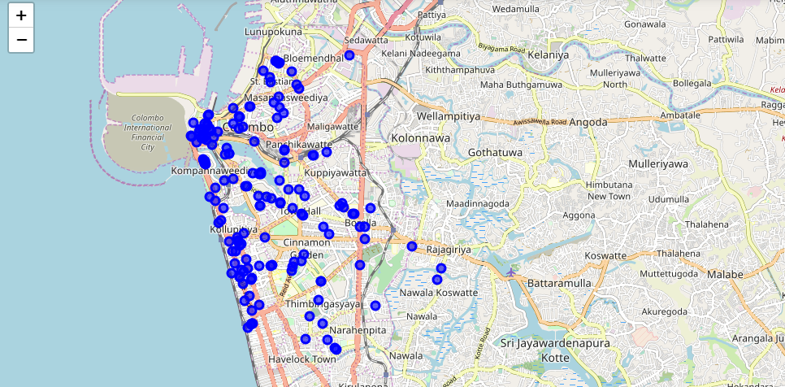
Restaurant layout in Colombo

Slide 5
Conclusion
According to analysis the best location is to opena restaurant is Borella

